Slide 1

Film Adaptations of Books: Looking at the Numbers
A Data Science Project by Noah Jett

Slide 2



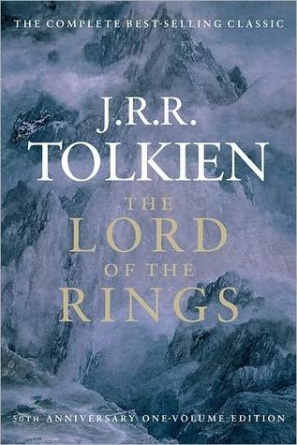
Books
Movies
?
This Photo by Unknown Author is licensed under CC BY-NC-ND

Slide 3
Research Questions
Are books with movie adaptations rated higher than those without?
Are movies based on books rated higher than those that are not?
Can book information predict movie rating accurately? Or:
Would my favorite book make a good movie?
Can book information classify its likelihood of being made into a movie? Or:
Will my favorite book be made into a movie?

Slide 4
Datasets
Goodreads Books
~15,000 entries
Information about books, including rating info
From Kaggle
Sourced through public Goodreads API
TMDB 5000 Movie Dataset
~5000 entries
Movies with info, including rating
From Kaggle
Website provided directly

Slide 5
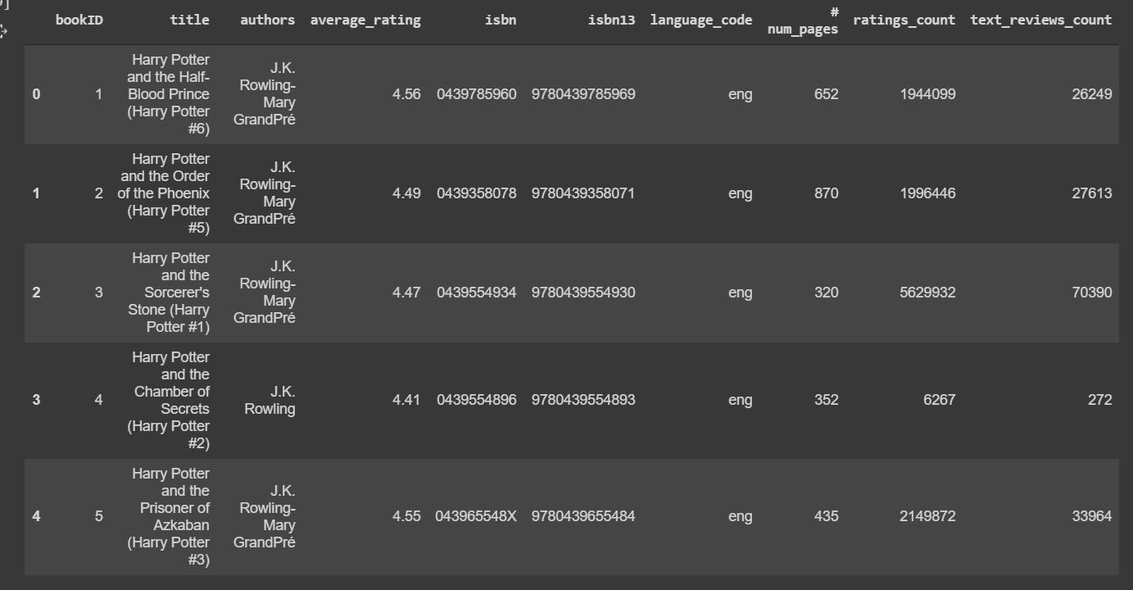
Books Dataset

Slide 6
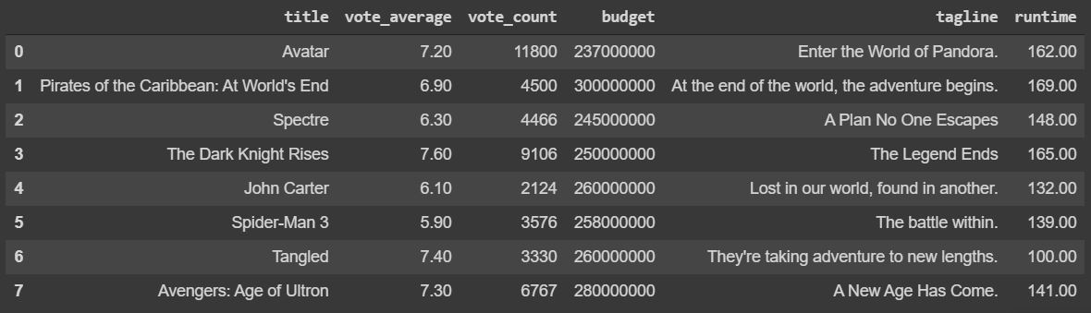
Movie Dataset

Slide 7
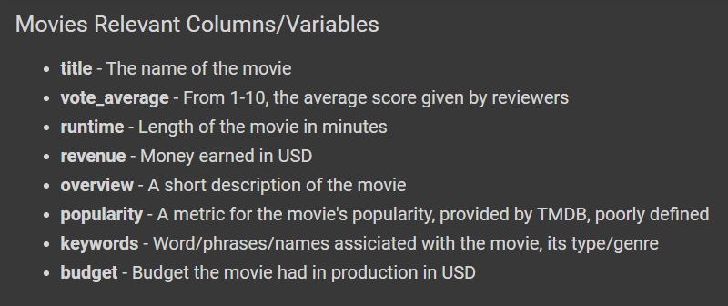
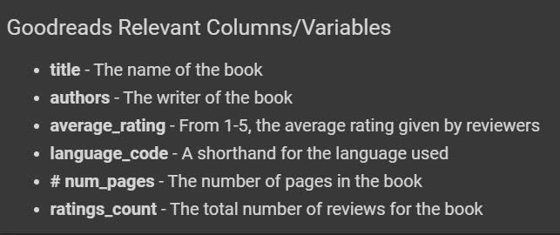

Slide 8
Overview
Books
Movies
I was interested in the overlap of the datasets
The goal is to merge the two, to create a final dataset where each entry(row) is a Property which has both a book and a movie, and their corresponding information

Slide 9

BOOKS
MOVIES

Slide 10
Merging Problems and Solution
‘Naive Merge’
Take the two datasets, smash them together, see what happens
Pd.concat(books,movies)
2 Major Problems with non-obvious solutions
Only matches on exactly the same titles
Titles can be the same, but be different things
E.g. Hatchet the survival novel, and Hatchet the New Orleans slasher flic

Slide 11
Partial String matching to solve Problem 1
Brought in ‘fuzzywuzzy’ Python library, which calculates the Levenshtien distance between two strings
(Basket, Basketball) = 60%
Set threshold for acceptance (70%)
Optimize

Slide 12
Searching Meta-data to solve Problem 2
How do we guarantee a matched pair are describing the same thing?
Create a verification function
There were a couple “cross-referencing” factors
Checks for explicit mention of book in movie overview/tagline
Book author cited in movie credits
Used this function to balance title-matching threshold
Set to lower percentage, then let verify() ‘catch’ those that slip through

Slide 13
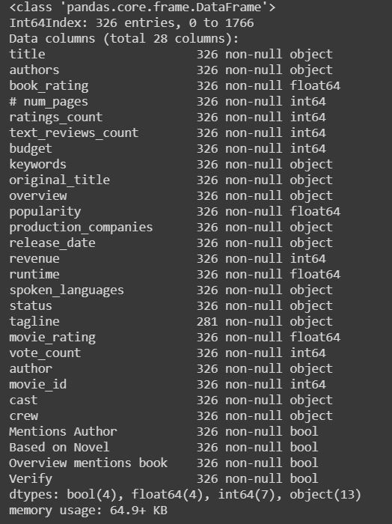
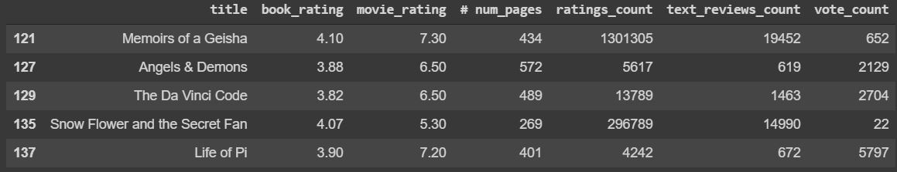
Merged Dataset

Slide 14
Research Question 1
Are books with movie adaptations rated higher than those without?
Use Levene’s Test for homogeneity of variances
P-value = 0.0017 < 5% confidence interval
Reject the null hypothesis of equal ratings
Welch’s T-Test (for unequal variances) 95% confidence interval:
Results: P-value = 0.3371 !< .05
Interpretation: We can NOT reject the null hypothesis that the ratings are equal. We conclude that, in our dataset, there is not a significant difference in ratings between books with movies and those without.

Slide 15
Research Question 2
Are movies based on books rated higher than movies that are not?
Levene’s Test:
P-value = 0004 < 5% confidence interval
Reject the null hypothesis of equal variance
Welch’s T-Test, 95% confidence interval:
Result: P-value = 4.981 !< .05
We can not reject the null hypothesis of equal averages. We conclude that movies based on books do not have significantly different ratings than those without.

Slide 16
“Would my favorite book make a good movie?”
Given some factors about a book, can we predict what score it would get as a movie?
Trying to find relationship between two continuous variables
Set up Linear regression:
<book_rating, ratings_count, # pages> → (movie_rating)

Slide 17
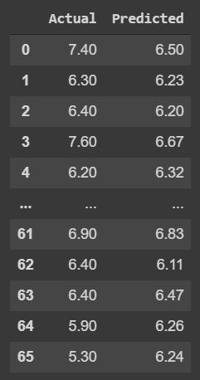
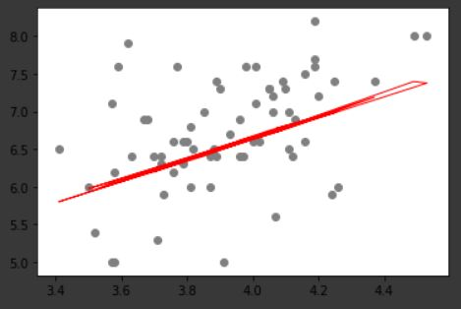
Model R-squared = .19. The model predicts 19% of the variability in movie rating.
movie_rating = 1.005 + (1.40*book_rating) + (4.92e-08*ratings_count) + (8.52e-05*#num_pages)

Slide 18
“Will my favorite book be made into a movie?”
I would like to predict whether a book is likely to be made into a movie. Put data into binary classification of (1=made into movie, 0 = not made into movie), use logistic regression to predict an outcome
Similar to linear regression, pick predictors that are correlated with the outcome
<average_rating, text_reviews_count> → (Made into movie)
‘Ratings_count’ is also correlated with the outcome, but has a high level of multicollinearity with ‘text_reviews_count’

Slide 19
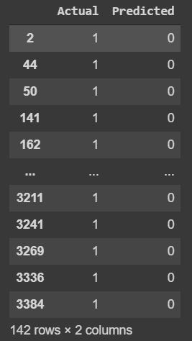
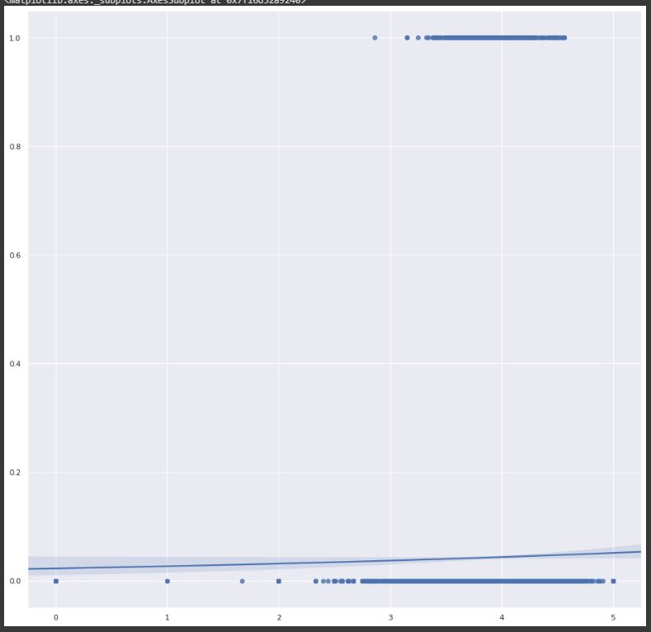
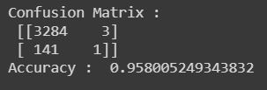
Initial attempt:
Used entire dataset. Only 300 out of 15,000 books were made into a movie.
The model learned that predicting 0 was very accurate. This isn’t good because it is predicting 1’s we care about
Problem: Trained model on biased data, heavily weighted towards one answer

Slide 20
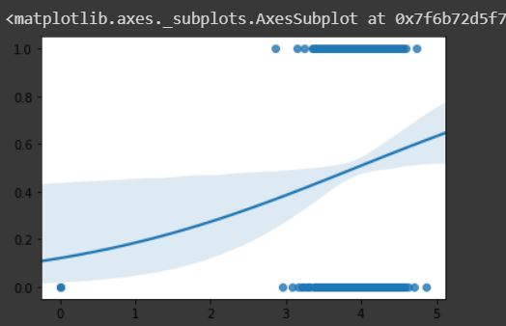
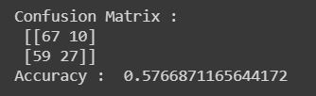
Logistic Regression (cont.)
Retrain model on unbiased dataset
Results:
Tested accuracy of 57.7%
The graph begins to show a sigmoid curve, as expected from logistic regression.

Slide 21
Things that could be improved
Interface
Accuracy of models
What really predicts whether a book is made into a movie? I bet it has to do with the author’s popularity. Could merge dataset of popular authors, NYT bestsellers, add to logistic regression.
Verification could be more accurate
Is currently ‘restrictive’. Guarantees that matches are really the same, but excludes some that probably should match

Slide 22
Conclusion
Are books with movie adaptations rated higher than those without?
No
Are movies based on books rated higher than those that are not?
No
Can we predict a movie’s rating based on book info?
Yes, we can predict 19% of the variability in movie ratings
Can we predict whether a book will be made into a movie?
Yes, with 57% accuracy

